Slide 1
Pair Programming
Discussion
By Alex Howson

Slide 2
Agenda
01. Pair Programming
02. Methodologies
An introduction into pair programming
The means by which pair programming can be carried out
03. Benefits
04. Drawbacks
05. Discussion
Benefits I have witnessed with pair programming from first-hand experience
Drawbacks I have witnessed with pair programming from first-hand experience
Discussion about pair programming and where we might want to consider using it

Slide 3
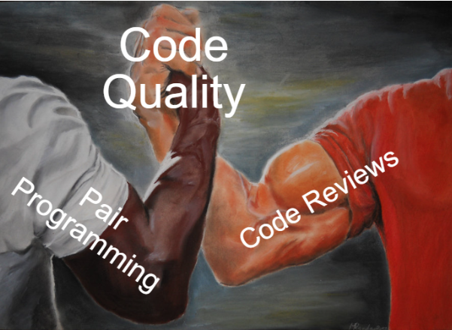
Pair Programming
Pair programming is the process of a pair of programmers alternating between a “driver” and “navigator” roles with the aim of writing code of value for a business need.

Slide 4
Roles
Roles
Driver – The person writing the code asking the design questions
Navigator – The person leading the design and answering the design questions from the driver

Slide 5
Methodologies Pomodoro
Pomodoro
Pomodoro is a time-based means of pair programming. The role switching occurs after a certain time limit.
Benefits
- Good for tracking when to take breaks from development
Drawbacks
- Forgetting to set or going past the timer leading to fixed driver/ navigator roles.
- Context switching at disruptive points during the pairing

Slide 6
Methodologies Ping Pong
Ping Pong
Ping pong is a context means of pair programming. The role switching occurs after a passing unit test when using a test-driven approach.
Benefits
- Good for tracking when to switch roles
- Less disruptive when switching roles
Drawbacks
- Not good for tracking when to take breaks

Slide 7
Benefits
Live Code Review
One of the main benefits of pair programming is this idea of a “live code review”. Whether pair programming eliminates the needs for code review itself is another discussion. However, what I can attest to is the notion of “nowhere to hide” a competent pair will pick up on corner cutting as well as the best approaches to take with a given implementation. Sometimes the experience of the pair is limited so a “mob” workshop might need to be considered.
Learn From Coworkers
Pair programming provides an excellent opportunity to learn from one another. Experienced developers can learn fresh approaches, junior developers have the potential of learning the ropes faster. Pairing is also good for learning new areas of a codebase and its domain. This breaks down knowledge silos and single points of failure within the team E.G the resident compounds expert is off sick today/ leaves the company when critical delivery is due.
Increase Team Cohesion
Each developer brings their own perspective, approach and point of view to the main job of software development which is problem solving. These unique approaches can create friction within especially new teams if left unchecked. Pair programming confronts this head on and forces co-operation and understanding to different ways of approaching/ solving problems as well as ways of working.

Slide 8
Drawbacks
Inflexible Work Schedule
One of the downsides to pair programming is it doesn’t promote any degree of flexibility in a working schedule. This creates difficulties with organising away from desk errands and other life responsibilities/ distractions that disrupt the pair when it is an enforced way of working.
Differently Focused Developers
It is important to state people aren’t lazy. People can become differently focused on something that lacks responsibility (“laziness”) occurring from a sense of boredom from a lack of engagement in the important task.
Keeping this in mind, at best when the pair extends past a pair of programmers to become a “mob” (Not a mobbing workshop) you will get spectators that are passive to the problem-solving process who get bored and become waste to the development effort.
The same occurs when the work is menial for the driver role. The navigator becomes a code quality spectator at best and at worst waste to the development effort.

Slide 9
Drawbacks
Untrusted Pairing Groups
In teams where trust is an issue pair programming can start to form some nasty restrictions around whom can pair with whom.
This team mindset forms out of trusted and untrusted individuals within a team. Certain team members or interactions between team members aren’t entrusted to get the work done/ to a high enough standard/ to a fast enough delivery.
Gatekeeping processes isn’t healthy for any team and steps should be taken to work out the issues with why certain pairs are less effective. This could involve explaining the importance of the delivery, addressing developer knowledge gaps, training on team agreed coding standards and so on.
Comfortable Pairing Groups
In a similar vein to the previous point in such a working environment and even less pressured environments comfortable pairing groups of colleagues that get along will occur. It is important when this pattern starts to form to address it to ensure the “mixing pot” approach to different culture and approaches to get the most out of the pair programming methodology.

Slide 10
Discussion

